Slide 1
Questioning: IS this?
Lesson 17
Working with mine, his, hers, opposites

Slide 2
Lesson 17
Objectives: At the end of this lesson, you will learn how to describe objects around you.
Students will learn how to distinguish between masculine and feminine objects
Students will learn how to say “ and” in Arabic

Slide 3
This
 |  | هذا | this, that, such, it, this one
 |  | هذه | this, such, that
 |  | هو | it, he, this, its
 |  | هؤلاء | these, those, that, this, these ones
 |  | هن | they, their, them, those, this

Slide 4
Yes/ No questions
You can form a question is Arabic to which the answer is either “yes” ______
Or “No” _______ by adding the question marker (hal) _______in front of a sentence

Slide 5
Ask: Do you have a PEN?

Slide 6
KEY-مِفْتَاح
Ask: Do you have a key?(F)
هذا

Slide 7
BOOK-كِتاب
Ask: Do you have a book?(M)

Slide 8
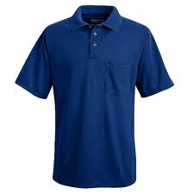
SHIRT-قَميص
Ask: Is this your shirt? (M)
هذا

Slide 9
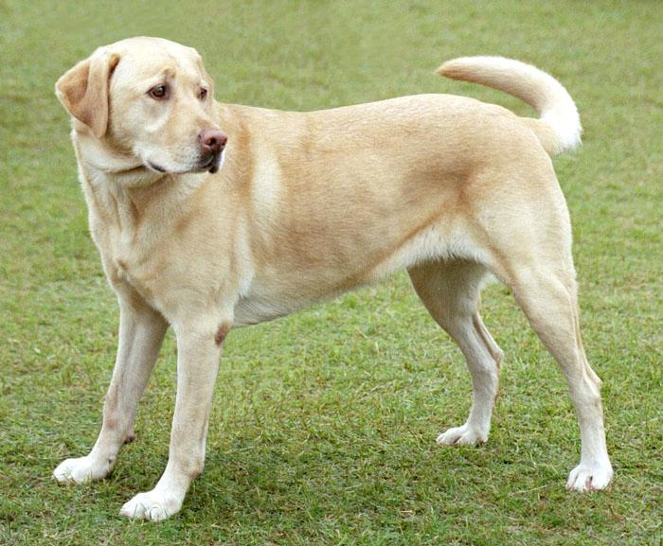
DOG-كَلْب
Ask: Is this your dog?

Slide 10
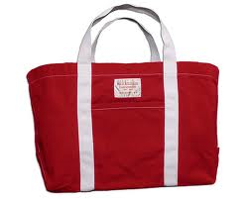
BAG-حَقيبة
Ask: Is this your bag? (F)
هذه

Slide 11
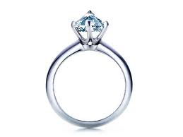
RING-خَاتِم
Say: This is my ring.

Slide 12
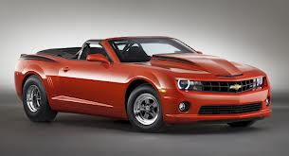
CAR-سيَّارة
Is this yours?

Slide 13
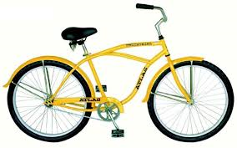
BICYCLE-دَرَّاجة
Is this yours?
هذه

Slide 14
BOY-وَلَد
This is my boy

Slide 15
Thank you-شُكْرًا

